Slide 1
More about inheritance
Exploring polymorphism
7.0

Slide 2
Main concepts to be covered
method polymorphism
static and dynamic type
overriding
dynamic method lookup
protected access

Slide 3
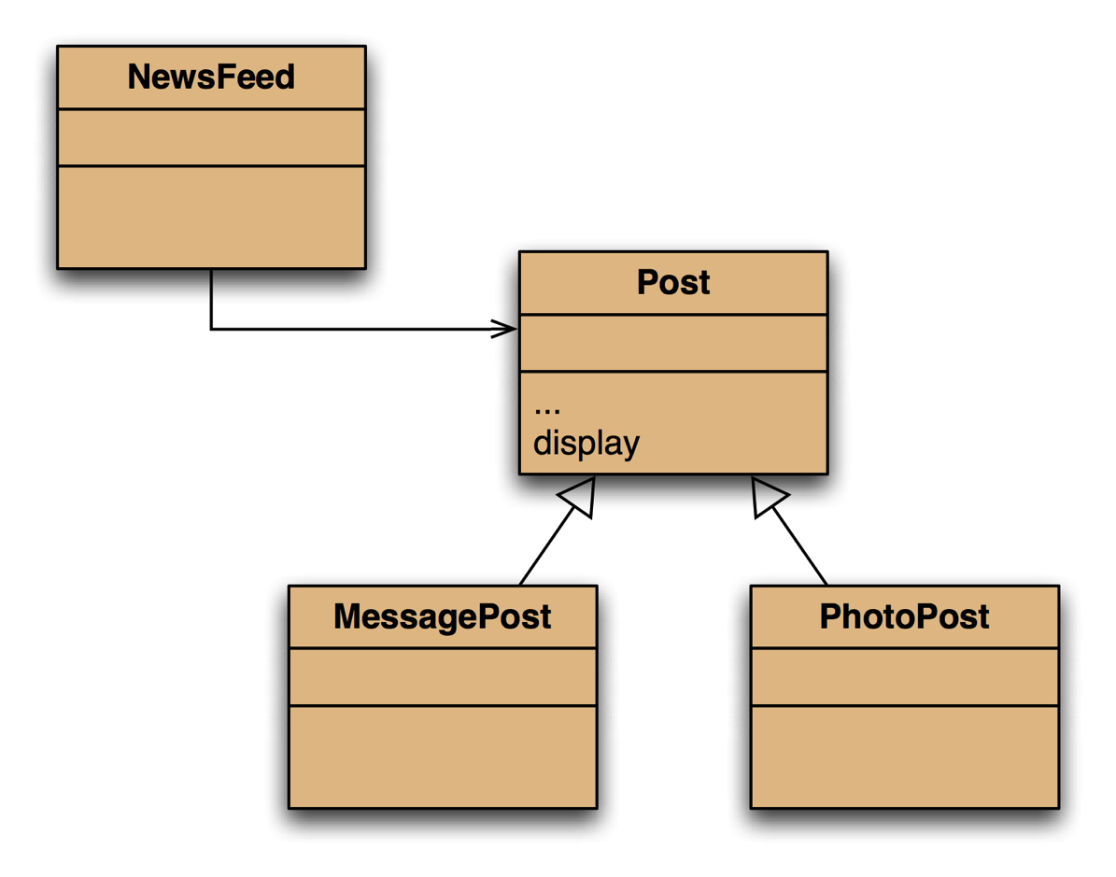
The inheritance hierarchy

Slide 4
Conflicting output
Leonardo da Vinci
Had a great idea this morning.
But now I forgot what it was. Something to do with flying ...
40 seconds ago - 2 people like this.
No comments.
Alexander Graham Bell
[experiment.jpg]
I think I might call this thing 'telephone'.
12 minutes ago - 4 people like this.
No comments.
What we want
Leonardo da Vinci
40 seconds ago - 2 people like this.
No comments.
Alexander Graham Bell
12 minutes ago - 4 people like this.
No comments.
What we have

Slide 5
The problem
The display method in Post only prints the common fields.
Inheritance is a one-way street:
A subclass inherits the superclass fields.
The superclass knows nothing about its subclass's fields.

Slide 6
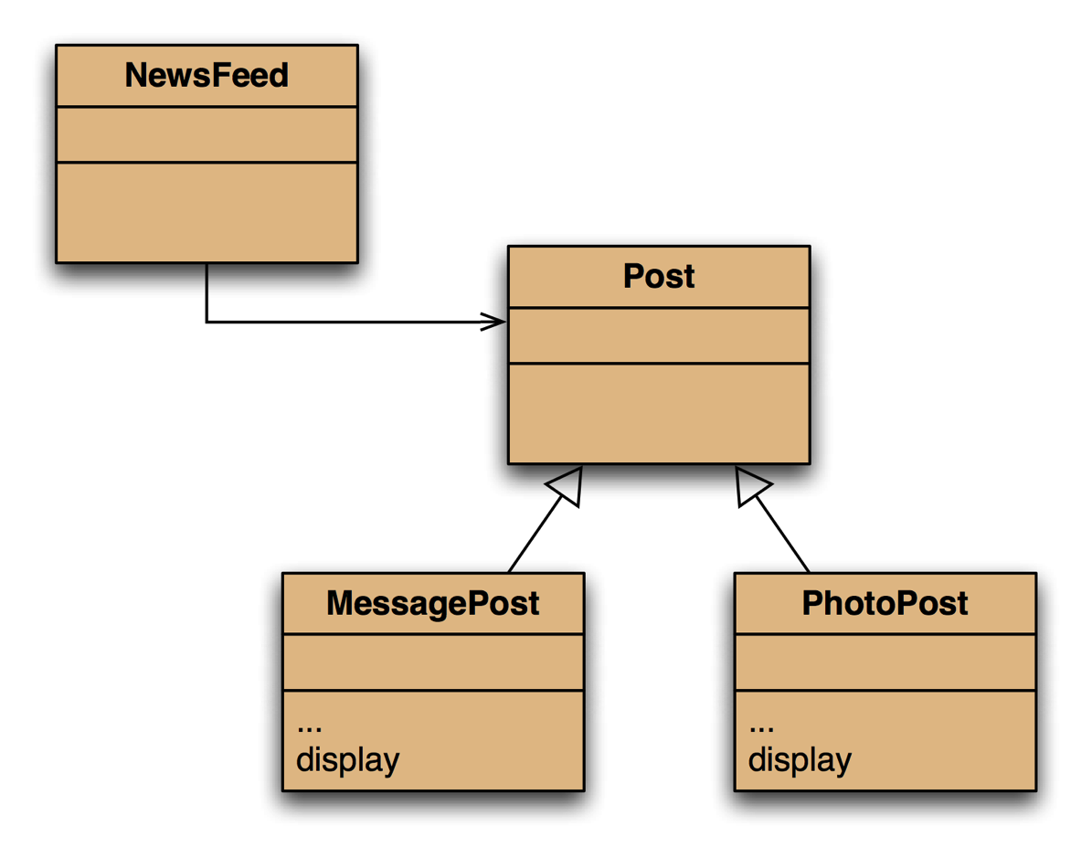
Attempting to solve the problem
Place display where it has access to the information it needs.
Each subclass has its own version.
But Post's fields are private.
NewsFeed cannot find a display method in Post.

Slide 7
Static type and dynamic type
A more complex type hierarchy requires further concepts to describe it.
Some new terminology:
static type
dynamic type
method dispatch/lookup

Slide 8
Static and dynamic type
What is the type of c1?
Car c1 = new Car();
What is the type of v1?
Vehicle v1 = new Car();

Slide 9
Static and dynamic type
The declared type of a variable is its static type.
The type of the object a variable refers to is its dynamic type.
The compiler's job is to check for static-type violations.
for(Post post : posts) { post.display(); // Compile-time error. }

Slide 10

Overriding: the solution
display method in both super- and subclasses.
Satisfies both static and dynamic type checking.

Slide 11
Overriding
Superclass and subclass define methods with the same signature.
Each has access to the fields of its class.
Superclass satisfies static type check.
Subclass method is called at runtime – it overrides the superclass version.
What becomes of the superclass version?

Slide 12
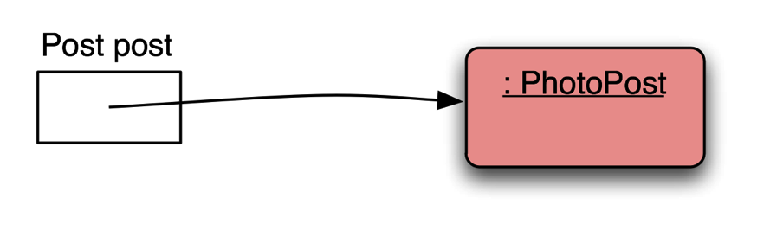
Distinct static and dynamic types

Slide 13
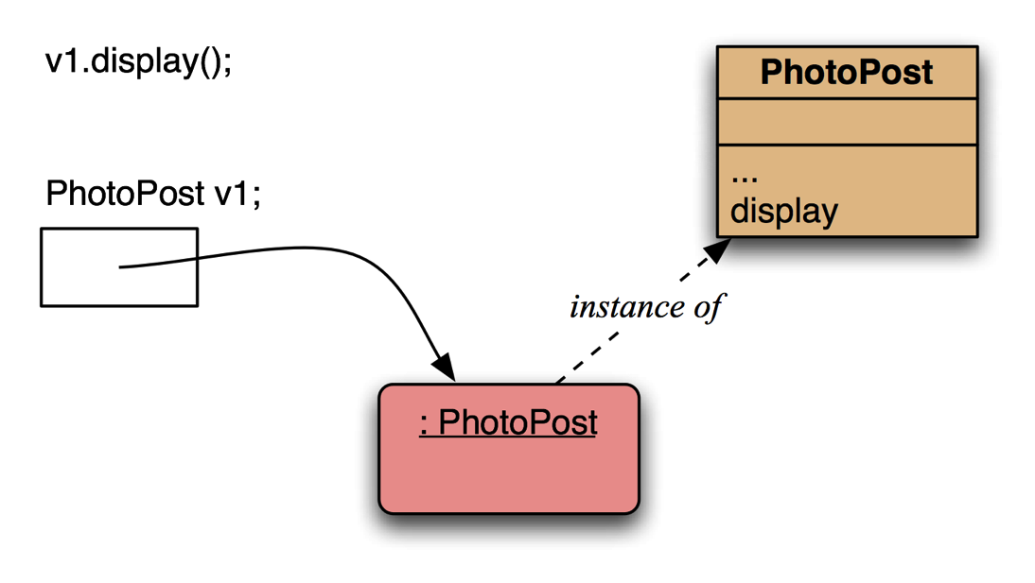
Method lookup
No inheritance or polymorphism. The obvious method is selected.

Slide 14
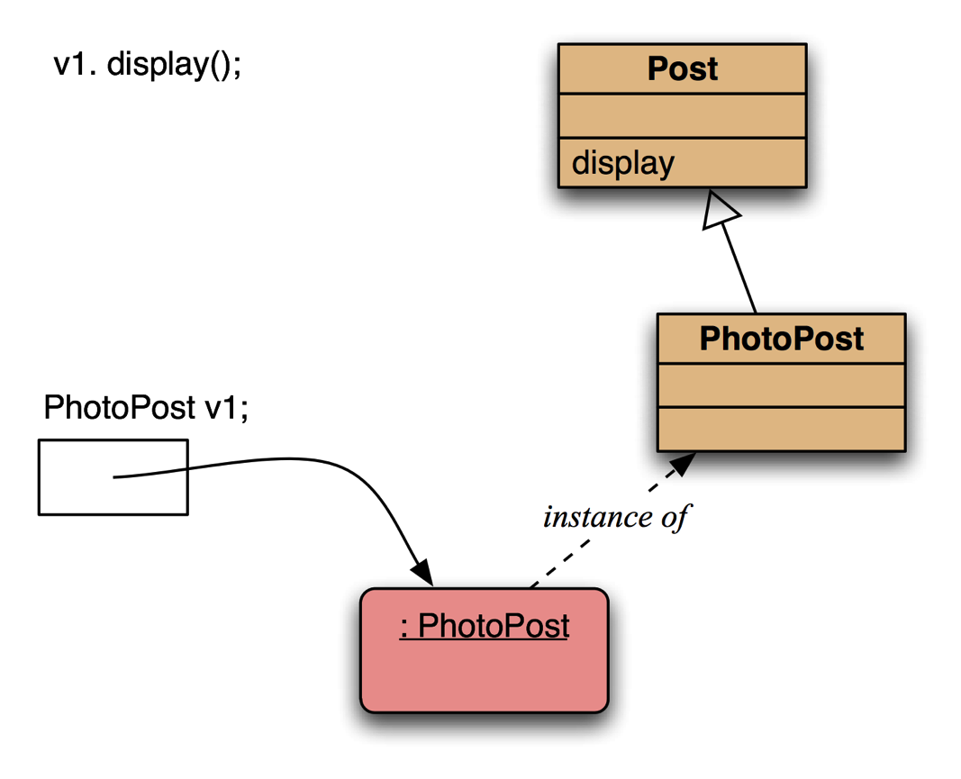
Method lookup
Inheritance but no overriding. The inheritance hierarchy is ascended, searching for a match.

Slide 15
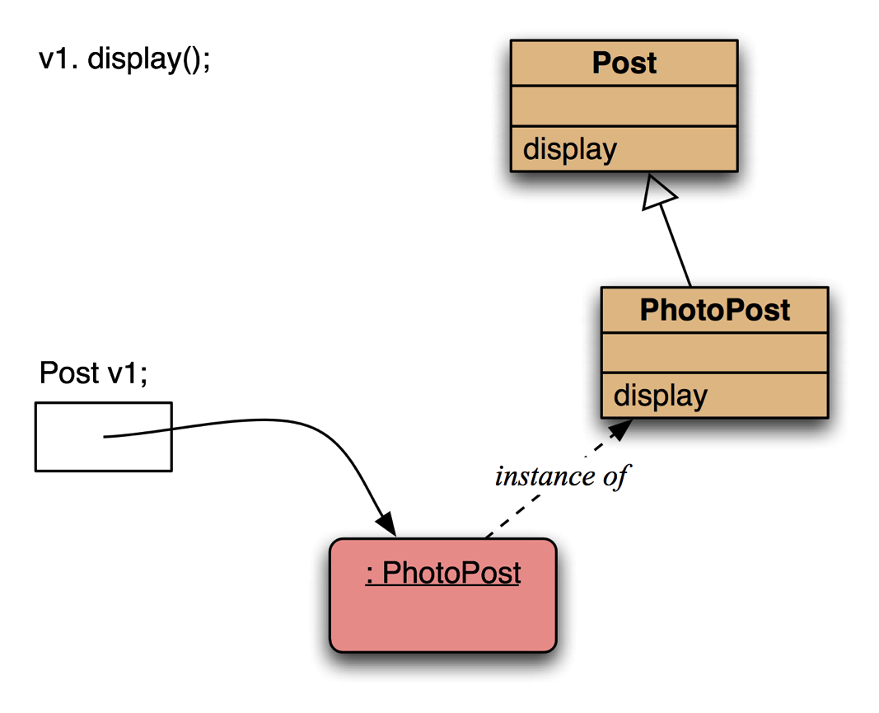
Method lookup
Polymorphism and overriding. The 'first' version found is used.

Slide 16
Method lookup summary
The variable is accessed.
The object stored in the variable is found.
The class of the object is found.
The class is searched for a method match.
If no match, the superclass is searched.
This is repeated until a match is found, or the class hierarchy is exhausted.
Overriding methods take precedence – they override inherited copies.

Slide 17
Super call in methods
Overridden methods are hidden ...
... but we often still want to be able to call them.
An overridden method can be called from the method that overrides it.
super.method(...)
Compare with the use of super in constructors.

Slide 18
Calling an overridden method
public void display()
{
super.display();
System.out.println(" [" + filename + "]");
System.out.println(" " + caption);
}

Slide 19
Method polymorphism
We have been discussing polymorphic method dispatch.
A polymorphic variable can store objects of varying types.
Method calls are polymorphic.
The actual method called depends on the dynamic object type.

Slide 20
The instanceof operator
Used to determine the dynamic type.
Identifies 'lost' type information.
A new variable of the matching type is declared if the condition is true:
if(post instanceof MessagePost msg) { … access MessagePost methods via msg … }

Slide 21
The Object class's methods
Methods in Object are inherited by all classes.
Any of these may be overridden.
The toString method is commonly overridden:
public String toString()
Returns a string representation of the object.

Slide 22
Overriding toString in Post
public String toString()
{
String text = username + "\n" + timeString(timestamp);
if(likes > 0) {
text += " - " + likes + " people like this.\n";
}
else {
text += "\n";
}
if(comments.isEmpty()) {
return text + " No comments.\n";
}
else {
return text + " " + comments.size() +
" comment(s). Click here to view.\n";
}
}

Slide 23
Overriding toString
Explicit print methods can often be omitted from a class:
System.out.println(post.toString());
Calls to println with just an object automatically result in toString being called: System.out.println(post);

Slide 24
StringBuilder
Consider using StringBuilder as an alternative to concatenation: StringBuilder builder = new StringBuilder(); builder.append(username); builder.append('\n'); builder.append(timeString(timestamp)); … return builder.toString();

Slide 25
Object equality
What does it mean for two objects to be 'the same'?
Reference equality.
Content equality.
Compare the use of == with equals() between strings.

Slide 26
Overriding equals
public boolean equals(Object obj)
{
if(this == obj) {
return true; }
if(!(obj instanceof ThisType)) {
return false; }
ThisType other = (ThisType) obj;
… compare fields of this and other …
}

Slide 27
Overriding equals in Student
public boolean equals(Object obj)
{
if(this == obj) {
return true; }
if(!(obj instanceof Student)) {
return false;
}
Student other = (Student) obj;
return name.equals(other.name) &&
id.equals(other.id) &&
credits == other.credits;
}

Slide 28
Overriding hashCode in Student
public int hashCode()
{
Objects.hash(name, credits, id
}

Slide 29
Protected access
Private access in the superclass may be too restrictive for a subclass.
The closer inheritance relationship is supported by protected access.
Protected access is more restricted than public access.
We still recommend keeping fields private.
Define protected accessors and mutators.

Slide 30
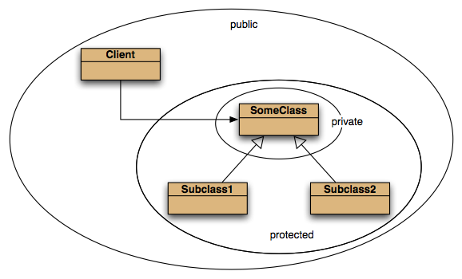
Access levels

Slide 31
Limits of inheritance
Inheritance supports code reuse.
Composition also supports reuse.
An instance field of a library type is a typical example of composition.
Composition is sometimes more appropriate than inheritance.

Slide 32
Inappropriate inheritance
A stack is a well-known data structure providing last-in first-out (LIFO) access to its elements via push and pop operations.
Stack in java.util has push and pop methods.
Stack extends Vector, which is similar to ArrayList.
The inherited methods are not appropriate in a stack data structure.

Slide 33
Inappropriate inheritance
Elements could be added to and removed from somewhere other than the top of the stack, via the inherited methods.

Slide 34
Stack via composition
Only push and pop are available from Stack, but the Vector code can still be used to manage the elements in the stack.

Slide 35
Limiting inheritance: final
Subclasses can be prevented by designating a class as final: public final class String
Prevents subclasses from breaking the immutable nature of strings, for instance.

Slide 36
Limiting inheritance: sealed
We can prevent unlimited extension of a superclass by sealing it and naming the permitted subclasses: public sealed class Post permits MessagePost, PhotoPost
This makes it easier to ensure that subclasses will respect features of their superclass, for instance.

Slide 37
Limiting inheritance: sealed
The compiler can also check that all subtypes have been considered.
No 'default' case needed.
switch(post) {
case MessagePost messagePost ->
formattedPost += messagePost.getText() + '\n';
case PhotoPost photoPost ->
formattedPost += " [" + photoPost.getImageFile() + "]\n " + photoPost.getCaption() + '\n';
}

Slide 38
Review
The declared type of a variable is its static type.
Compilers check static types.
The type of an object is its dynamic type.
Dynamic types are used at runtime.
Methods may be overridden in a subclass.
Method lookup starts with the dynamic type.
Protected access supports inheritance.

